Slide 1
BT 101 MODERN BIOLOGY 3 0 0 6
Pre-requisite: Nil
Division IV:
Human physiology: biological axons and neurons, neuromuscular and synaptic junctions; sensory systems - hearing, taste, smell and visual receptors. Dr. Souptick Chanda
Texts:
J. L. Tymoczko, J. M. Berg and L. Stryer, Biochemistry, 5th Ed, W. H. Freeman & Co, 2002. 2. D. L. Nelson and M. M. Cox, Lehninger Principles of Biochemistry, Macmillan Worth, 2000.
References:
N. Hopkins, J. W. Roberts, J. A. Steitz, J. Watson and A. M. Weiner, Molecular Biology of the Gene, 4th Ed, Benjamin Cummings, 1987.
C. R. Cantor and P. R. Schimmel, Biophysical Chemistry (Parts I, II and III), W.H. Freeman & Co., 1980.
3. C. C. Chatterjee, Human Physiology, Vol 1 & 2, 11th Ed, Medical Allied Agency, 1987.
http://shilloi.iitg.ernet.in/~biotech/BT%20Syllabus/BT%20101.htm
Text book of Medical physiology, Guyton and Hall

Slide 2
Grading Pattern
• Mid semester: 50 marks
• Quiz before mid semester: 10 marks
• Final semester : 50 marks
• Quiz after mid semester: 10 marks
No re-examination
Attendance guidelines shall be strictly followed

Slide 3
Human physiology:
Nervous system, biological axons and neurons, neuromuscular and synaptic junctions;
Sensory systems - hearing, taste, smell and visual receptors;
Introduction to ANN.
Dr. Souptick Chanda,
BSBE, IIT Guwahati

Slide 4
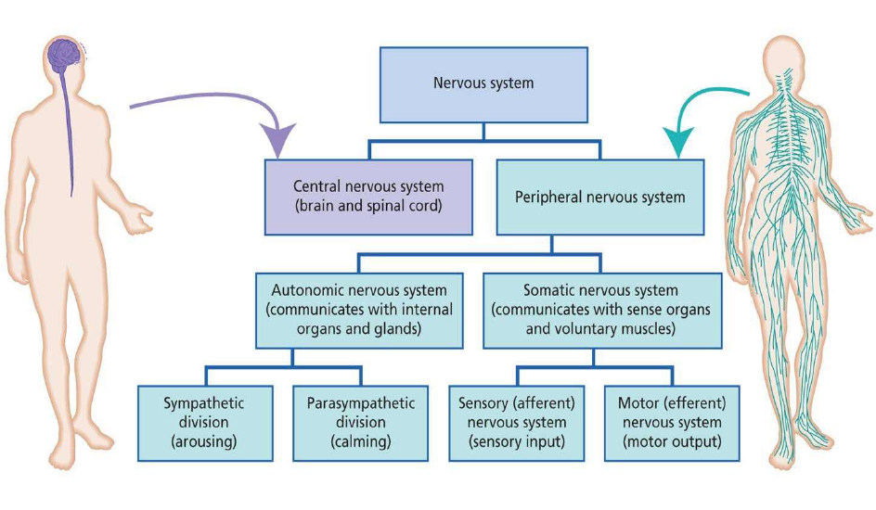
The Nervous System

Slide 5
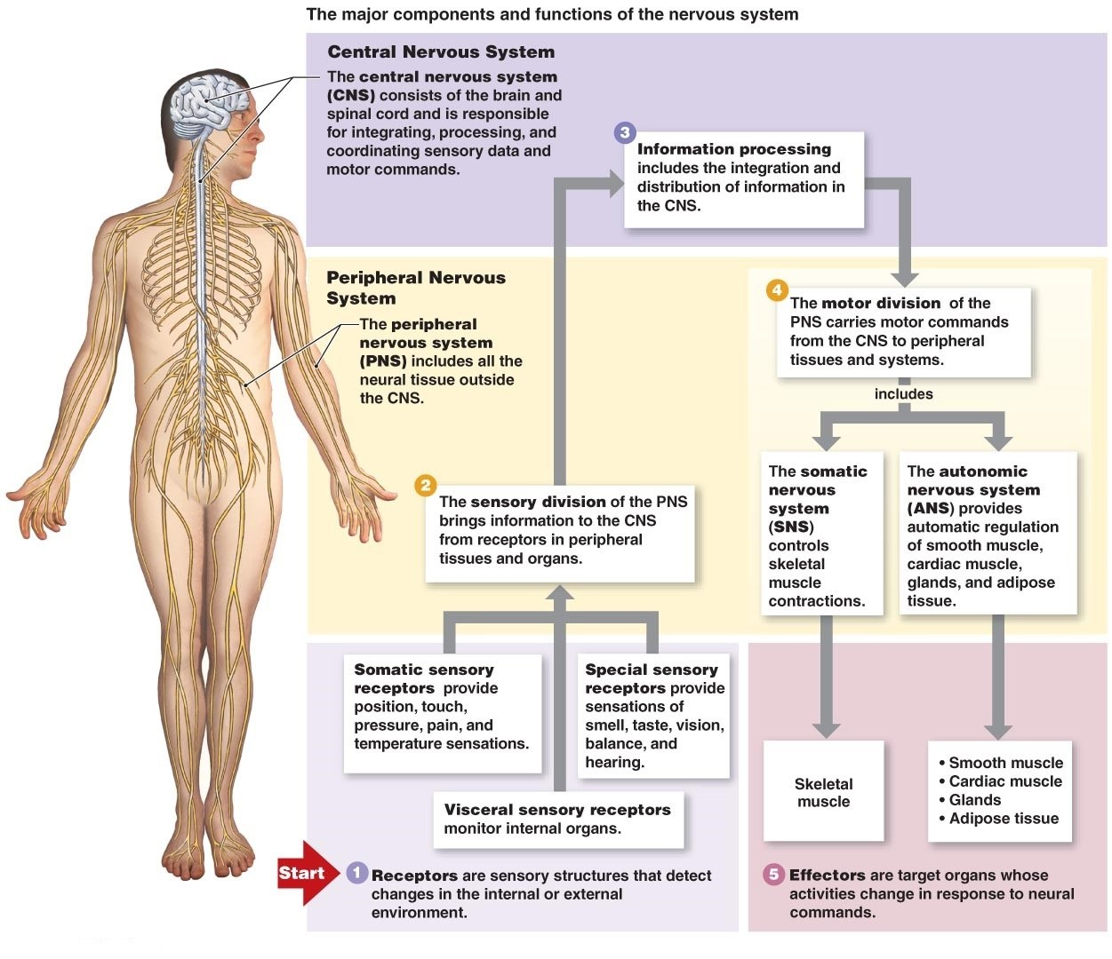
The major components and functions of the central nervous system (CNS)

Slide 7
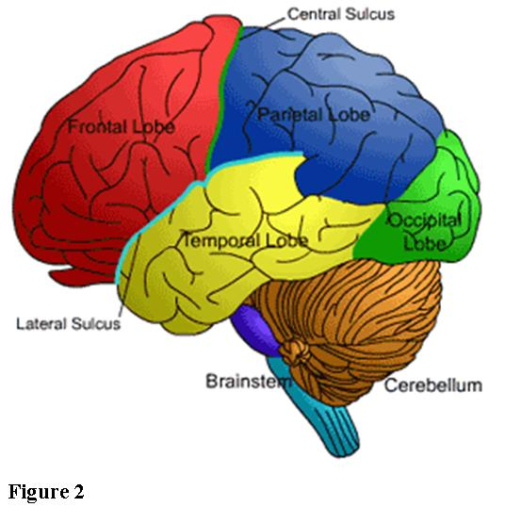
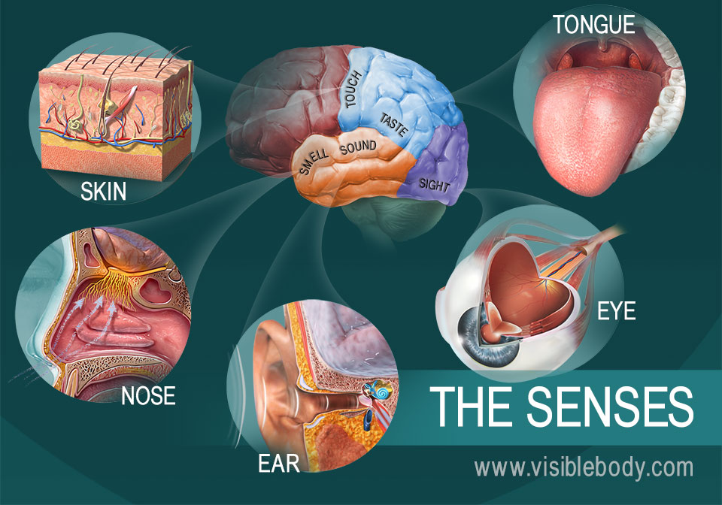
The Special Senses

Slide 8
In short, the nervous system has three overall functions:
Sensory function - sensory receptors detect the changes in the external environment.
Integrative function - The CNS integrates this information.
Motor function - effectors (muscles and glands) bring about a response.
Example: You are riding a bicycle and see that the traffic light has turned RED (sensory function). Your CNS integrates the information (RED light means ‘STOP’ - integrative function), and you use your muscles to apply your brakes to stop the bicycle (motor function).

Slide 9
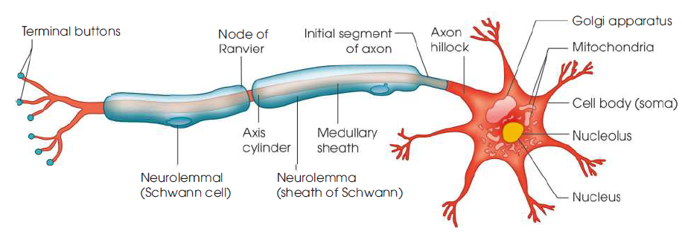
Neuron
The nervous system is composed of nervous tissue. The nervous tissue consists of two elements: Nerve cell or neuron and neuroglia. The neurons are the structural and functional units. They communicate with each other directly or indirectly through synapses. They are the electrically excitable cells and they transmit impulses via chemical and electrical signals.

